Slide 1
















DEALER MANAGEMENT SYSTEM
an integrated automobile dealer management software
BEST-IN-THE-CLASS Automobile Dealer Management System
Enhances Customer Satisfaction by 90%
Improves Dealer Collaboration by 60%
Increases Operational Efficiency by 80%
Promotes paperless operations by 100%
Improve overall ROI by 20%
Seamless coordination of all aspects of dealer management system, which leads to ultimate customer satisfaction & guaranteed delivery.
Less human intervention and no dependency on hierarchy, enabling unified function of all related parties for multiple locations dealer management.
Sharp decrease in manual inventory management which leads to operational excellence at all levels.
Promotes digital way of working and keeping records, thus reducing paper based evidence for dealer management including compliances and annual audits.
When all related resources are optimized, there is significant financial benefits across all cross functional areas which will lead to significant improvement in return-on -investments
OUR EXISTING CLIENTS ON AUTO-XPERT PLATFORM
OUR EXISTING CLIENTS ON AUTO-XPERT PLATFORM
OLIVE
A U T O
NEON
MOTORS
info@schemaxtech.com
https://www.schemaxtech.com
DEMO | TRIAL | YEAR AROUND SUPPORT SERVICES

Slide 2


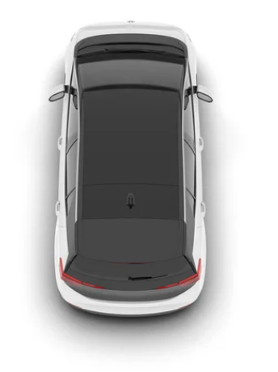












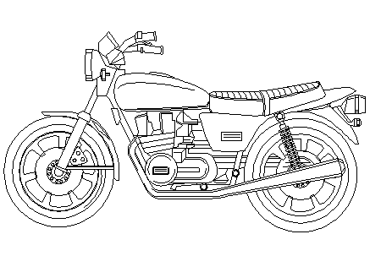





DEALER MANAGEMENT SYSTEM
an integrated automobile dealer management software
Product Features
Digital Dashboards for each Critical Function
Follow us on
Sales
Customer Relationship Management
Inventory Management
Sales dash boards for real time sales tracking for all related locations.
Spare parts
management
Vehicle Insurances
Physical inventory and Dead-stock reports for efficient inventory management.
Spare parts Transaction Reports.
Loan Management
Used Vehicle Trade Off
Service lead and follow-up scheduler to meet sales and operational targets.
Service Volume Reports.
Accounts
Alerts & Reports
Payments schedules and status report for effective collection of accounts receivables.
Loans management dash boards.
Vehicle Service Management
Used Vehicle Dash Boards
Diagnostic report Dash Board
User Dash Board
DEMO | TRIAL | YEAR AROUND SUPPORT SERVICES
info@schemaxtech.com
https://www.schemaxtech.com

